Slide 1

In Vehicle coupon recommendation
5509: Supervised Learning project

Slide 2
Sequence of work
About the Data
Data Cleaning
Data Exploration
Data Visualization
Feature Engineering
Model Design
Model Testing
Result and Analysis
Conclusion

Slide 3
About the data
UCI Library('A bayesian framework for learning rule sets for interpretable classification.' The Journal of Machine Learning Research)
Likelihood of a driver accepting coupon
Weather
Destination
Occupation
Education
26 Columns / Features
12684 Rows / Observations

Slide 4
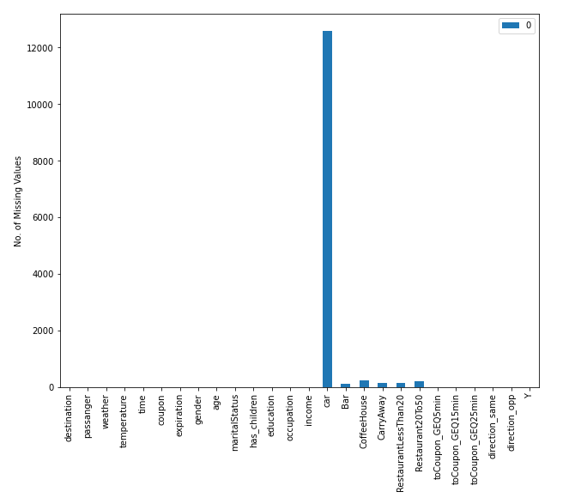
Data cleaning
Car column dropped
Remaining NA Rows Removed
Cleaned Data
25 Columns
12079 Rows

Slide 5

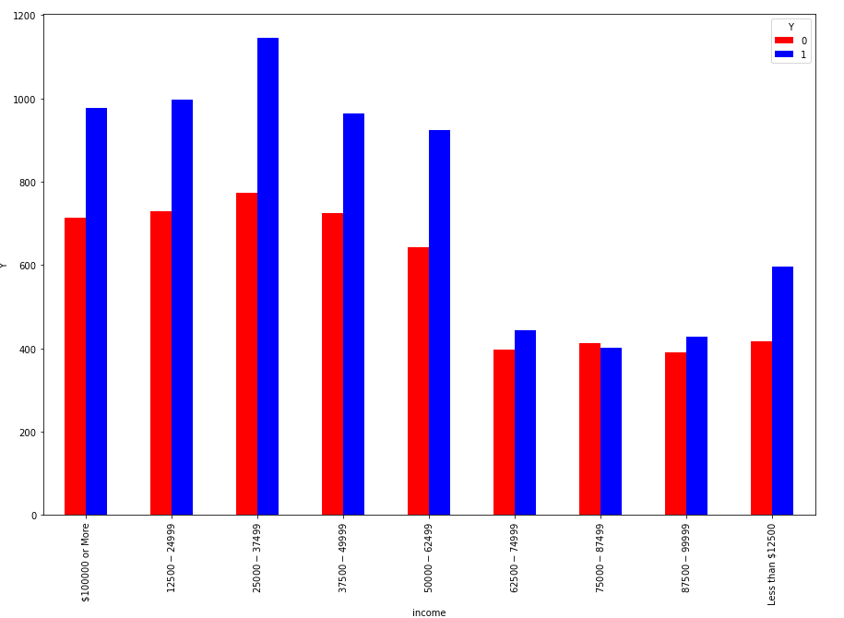
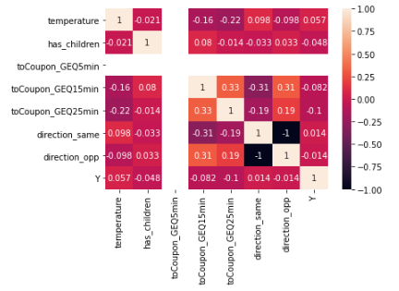
Exploratory data analysis
College Graduates more likely to accept Coupons
People earning 62000-10000$ less likely to accept
Additional Cleaning
Direction Same
Direction Opp
toCoupon GEQ_5mins

Slide 6
Additional steps
Feature Engineering
Encoding depending on class
Dividing into Train and Test Set
80/20 Ratio

Slide 7
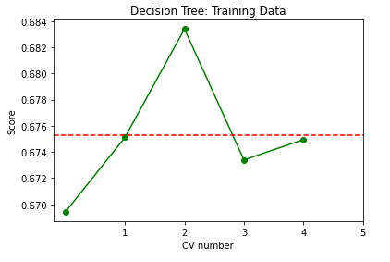
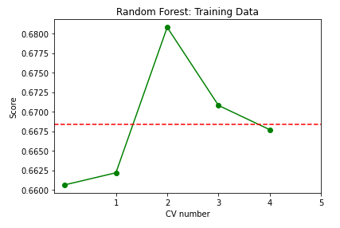
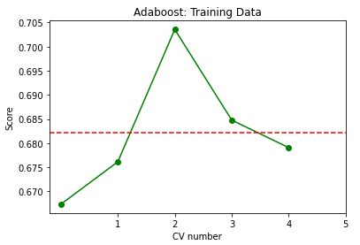
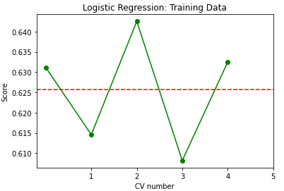
Model design
7 Supervised Learning Methods Used
Decision Tree
67.2%
Random Forest
67.3%
AdaBoost
67.9%
Logistic Regression
62.7%

Slide 8
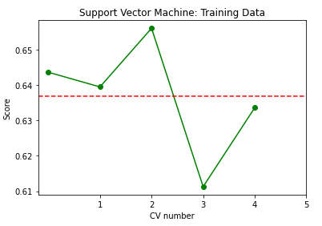
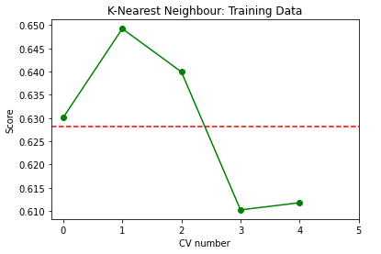
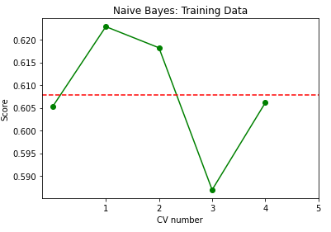
Model design
7 Supervised Learning Methods Used
Support Vector Machine
63.6%
K-nearest Neighbor
62.8%
Naïve Bayes
60.7%

Slide 9
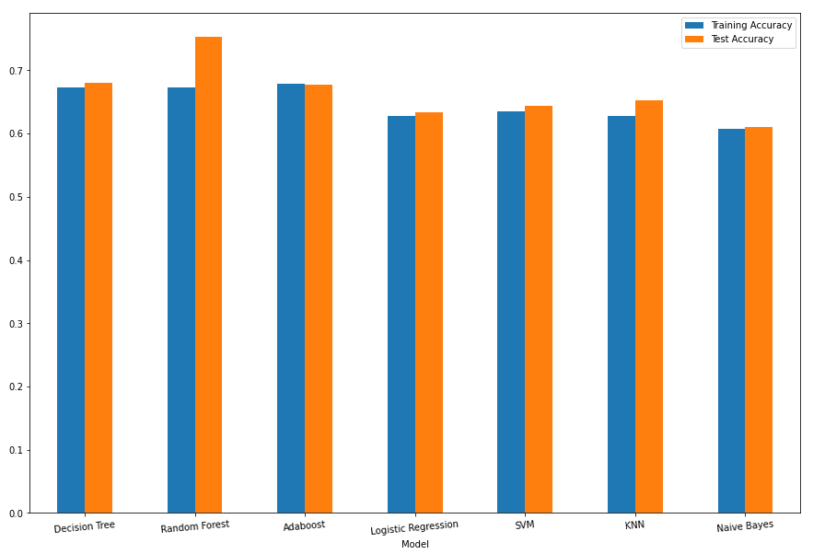
Results and analysis
Decision Tree
68%
Random Forest
75%
Adaboost
67.8%
Logistic Regression
63%
SVM
64%
KNN
65%
Naïve Bayes
61%

Slide 10
conclusion
Data Cleaning Absolutely Vital
Random Forest the best model in situation
Adjusting Hyper parameters

Slide 11
Thank you

